Slide 1
D-Optimality with Level Balance Constraints
Or, How to Optimize Simulated Patient Universes

Slide 2
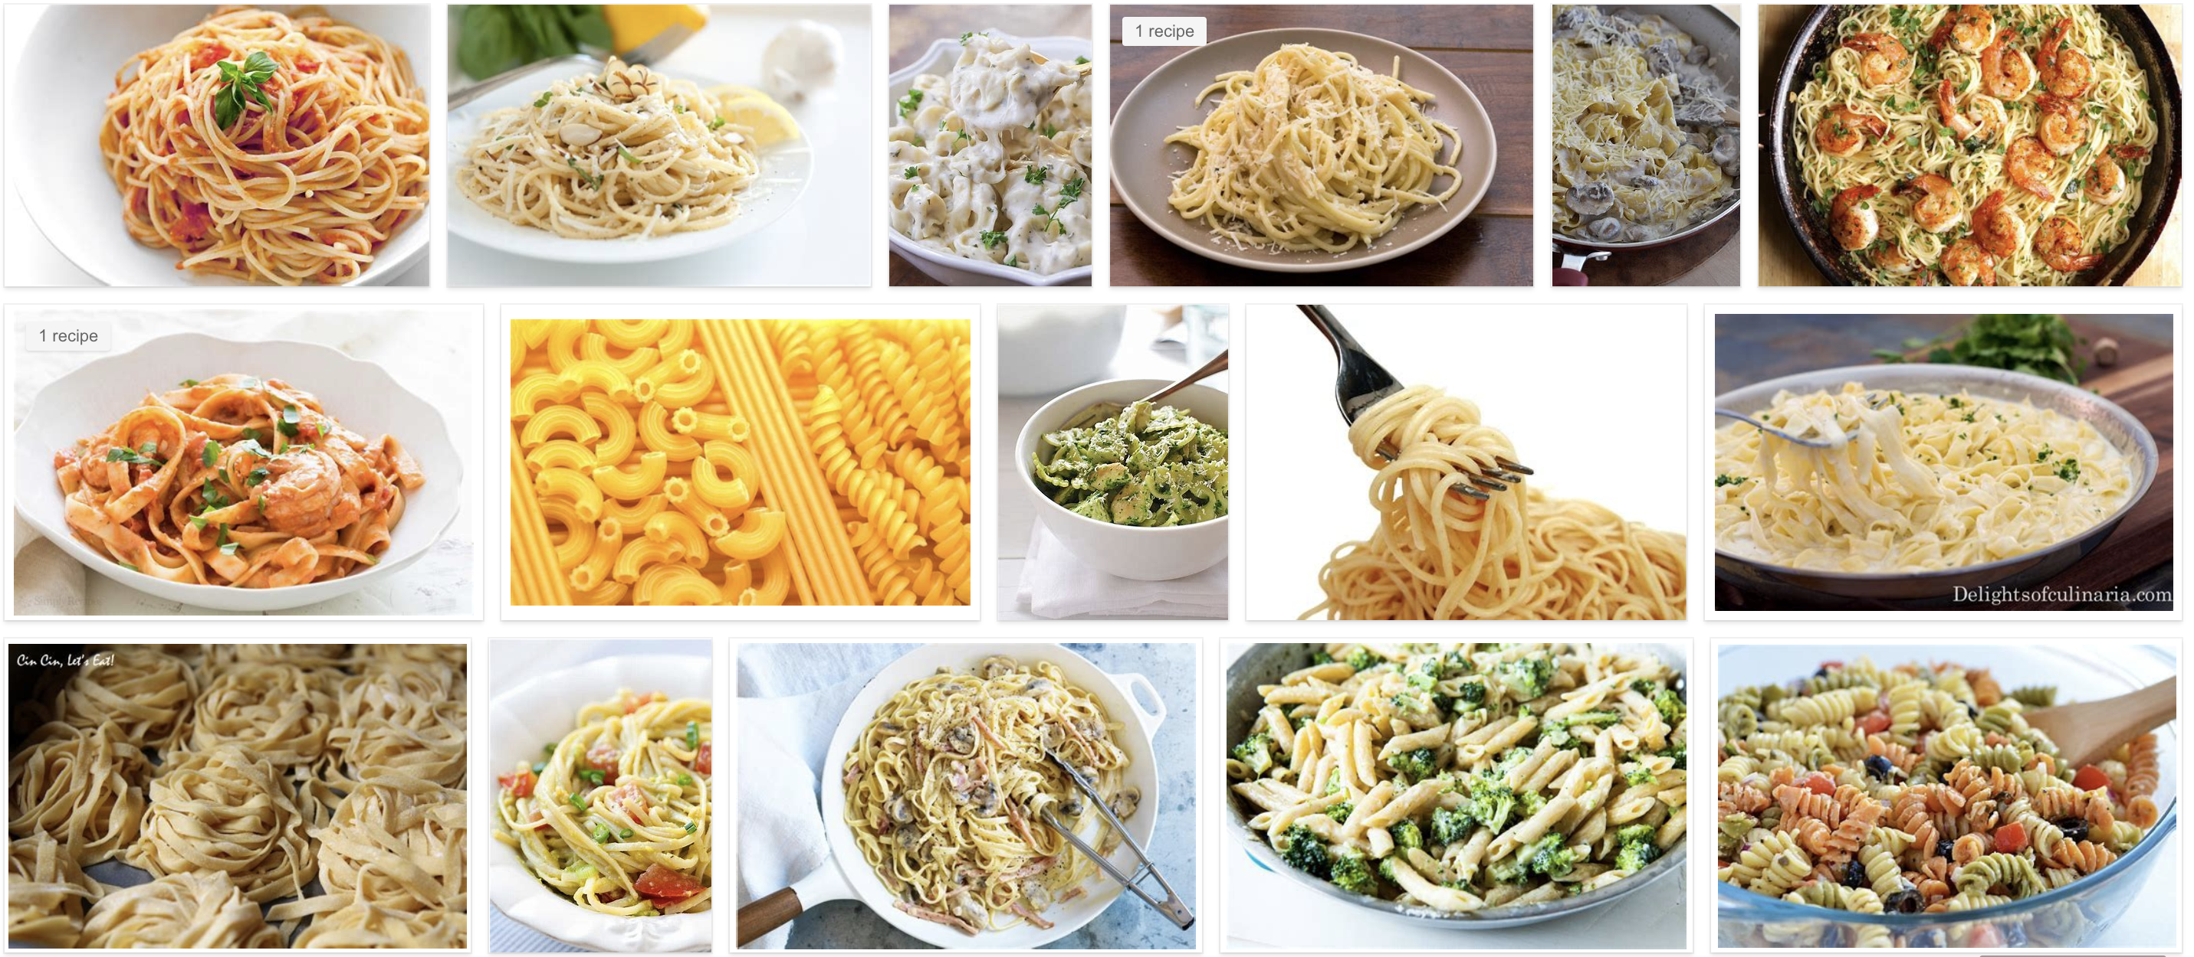
What is Conjoint Analysis?

Slide 3
Pasta Design
 | 0 | 1 | 2 | 3
Pasta | Spaghetti | Rotini | Linguini | Elbow
Sauce | Pesto | Marinara | Meat
Toppings | None | Parmesan | Meatballs
Dish # | Pasta | Sauce | Toppings
1 | 0 | 0 | 0
2 | 0 | 0 | 1
3 | 0 | 0 | 2
4 | 0 | 1 | 0
5 | 0 | 1 | 1
6 | 0 | 1 | 2
… | … | … | …
36 | 3 | 2 | 2

Slide 4
What is design efficiency?
The current standard used to identify ‘efficient design’ is D-error – the geometric mean of the eigenvalues of the covariance matrix (D-efficiency is the inverse of D-error)
D-efficient designs satisfy four principles (Kuhfeld, Huber, & Zwerina, 1996):
Orthogonality is satisfied when the levels of each attribute vary independently of one another.
Level balance is satisfied when the levels of each attribute appear with equal frequency.
Minimal overlap is satisfied when the alternatives within each choice set have nonoverlapping attribute levels.
Utility balance is satisfied when the utilities of alternatives within choice sets are the same.

Slide 5
Problem Background & Context: Pharmaceutical Market Research
A pharmaceutical market research firm uses simulated patient treatment as a method to understand physician demand in specific treatment areas.
The firm designs a (small) simulated universe of patients that represents the actual patient universe as closely as possible.
Physicians will treat simulated patients as they would in practice.
Based on treatment decisions, analysts can identify what patient attributes drive the choice for a particular treatment.

Slide 6
Problem Background & Context: Patient Design
Patients are defined by multiple attributes (age, gender, BMI, etc.)
Each attribute may have multiple levels (male/female, etc.).
The distribution of attribute levels is controlled such that the demographics of the simulated patient universe approximate the real patient universe.
When the number of attributes and levels grow beyond a small set, presenting the full design (full factorial) becomes a challenge due to both the number of combinations required and the amount of burden placed on the respondent.
Fractional factorial designs, then, seek to allow the research to eke as much data out of the analysis as possible but use a much more limited subset of stimuli – but how do we know what the best fractional factorial design is?

Slide 7
Key Differences between Conjoint and Patient Simulation
The design for patient simulation inherently contains d-error as a result of violating the principle of level balance: Since the goal is for the simulated patient universe to map to the actual patient universe, the researcher may need to control for the distribution of levels within each attribute.
Certain attributes and levels may have required interactions (i.e., a patient must be female to be pregnant), potentially violating orthogonality and minimal overlap.

Slide 8
How do we describe a Type 2 Diabetes patient?
 | 0 | 1 | 2 | 3 | Distribution
Age | Youth | Adult | Elderly |  | 25/50/25
Gender | Male | Female |  |  | 50/50
Race | Caucasian | African-American | Hispanic | Asian | 40/20/20/20
BMI | Underweight | Normal | Obese |  | 25/40/40
Diabetes | No | Yes |  |  | 50/50
Stroke | No | Yes, Treated |  |  | 75/25
Heart | No | Yes, Angina | Yes, MI |  | 50/25/25
LDL | Low | Moderate | High |  | 25/50/25
BP | Normal | Moderate | High |  | 25/50/25
A1C | Normal | Moderate | High | Very High | 25/25/25/25
Renal | Normal | Reduced | Impaired |  | 50/25/25
Creatinine | Normal | Mild | Moderate |  | 50/25/25
UACR | Normal | Microalbuminuria | Albuminuria |  | 33/33/33
Curr. Tx | None | ACE Inhibitor | Beta Blocker | CCB | 25/25/25/25
Heart Disease | None | Immediate family | Extended family |  | 50/25/25
Smoker | Non-smoker | Past | Current |  | 50/25/25
Type 2 Diabetes diagnosis and A1C are linked, we have the following interaction constraints:
Patients with normal A1C cannot have T2D, and
Patients with very high A1C must have T2D.
Notes:
Practically speaking, the number of attributes is limited to no more than 25, each with at most 5 levels due to the complexity of the simulation, limited respondent pool, and limited number of experiments possible per respondent. Thus, at most, the candidate set contains 5^25 (approx. 3x10¹⁷) possibilities – and will generally be significantly smaller as not all 25 attributes are used and most contain fewer than 5 levels. However, the worst-case scenario requires approximately 2x10¹⁰ gigabytes to merely store the candidate set. The combinatorics problem explains why stochastic search algorithms such as simulated annealing or genetic algorithms are frequently used instead of an exhaustive search against a complete candidate set.

Slide 9
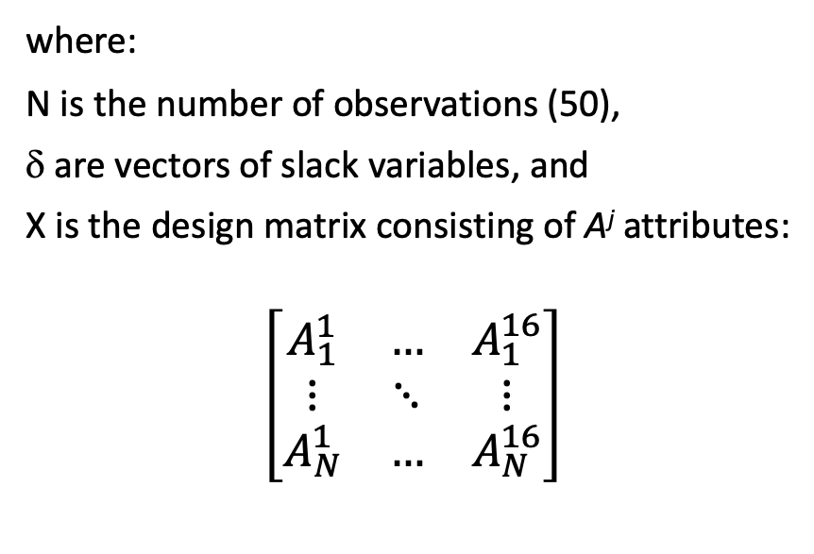
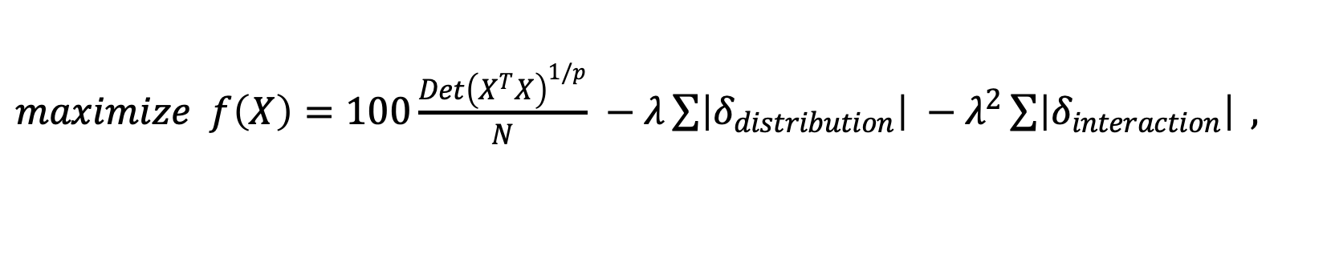
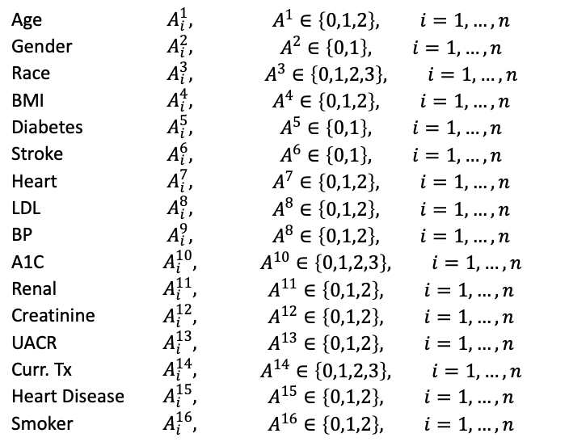
Optimization: How can we reduce the 30,233,088 distinct combinations into a 50-profiles fractional factorial design?
$maximize f\left(X\right)=100\frac{{Det\left(X^{T}X\right)}^{1/p}}{N} −λ\sum{\left|δ_{distribution}\right| }−λ^{2}\sum{\left|δ_{interaction}\right| },$
where:
N is the number of observations (50),
δ are vectors of slack variables, and
X is the design matrix consisting of A^{j} attributes:
$$\left[\begin{matrix}A_{1}^{1} & … & A_{1}^{16} \\ ⋮ & ⋱ & ⋮ \\ A_{N}^{1} & … & A_{N}^{16}\end{matrix}\right]$$
With decision variables A^{1…16} representing attributes:
Age | $$A_{i}^{1},$$ | $$A^{1}∈\left\{0,1,2\right\}, i=1,…,n$$
Gender | $$A_{i}^{2},$$ | $$A^{2}∈\left\{0,1\right\}, i=1,…,n$$
Race | $$A_{i}^{3},$$ | $$A^{3}∈\left\{0,1,2,3\right\}, i=1,…,n$$
BMI | $$A_{i}^{4},$$ | $$A^{4}∈\left\{0,1,2\right\}, i=1,…,n$$
Diabetes | $$A_{i}^{5},$$ | $$A^{5}∈\left\{0,1\right\}, i=1,…,n$$
Stroke | $$A_{i}^{6},$$ | $$A^{6}∈\left\{0,1\right\}, i=1,…,n$$
Heart | $$A_{i}^{7},$$ | $$A^{7}∈\left\{0,1,2\right\}, i=1,…,n$$
LDL | $$A_{i}^{8},$$ | $$A^{8}∈\left\{0,1,2\right\}, i=1,…,n$$
BP | $$A_{i}^{9},$$ | $$A^{8}∈\left\{0,1,2\right\}, i=1,…,n$$
A1C | $$A_{i}^{10},$$ | $$A^{10}∈\left\{0,1,2,3\right\}, i=1,…,n$$
Renal | $$A_{i}^{11},$$ | $$A^{11}∈\left\{0,1,2\right\}, i=1,…,n$$
Creatinine | $$A_{i}^{12},$$ | $$A^{12}∈\left\{0,1,2\right\}, i=1,…,n$$
UACR | $$A_{i}^{13},$$ | $$A^{13}∈\left\{0,1,2\right\}, i=1,…,n$$
Curr. Tx | $$A_{i}^{14},$$ | $$A^{14}∈\left\{0,1,2,3\right\}, i=1,…,n$$
Heart Disease | $$A_{i}^{15},$$ | $$A^{15}∈\left\{0,1,2\right\}, i=1,…,n$$
Smoker | $$A_{i}^{16},$$ | $$A^{16}∈\left\{0,1,2\right\}, i=1,…,n$$

Slide 10
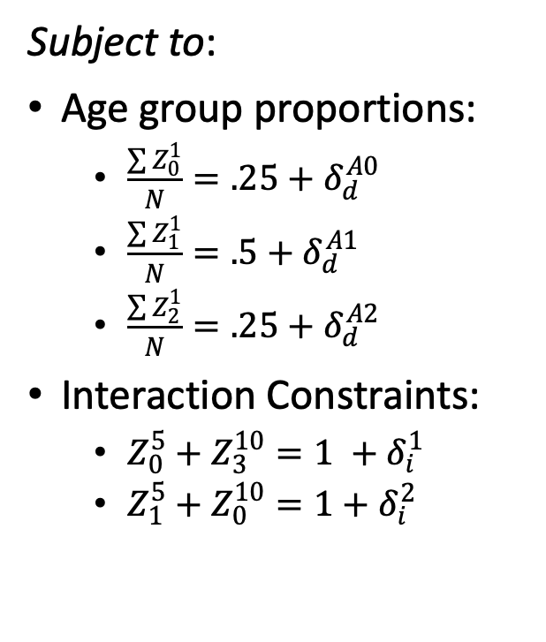
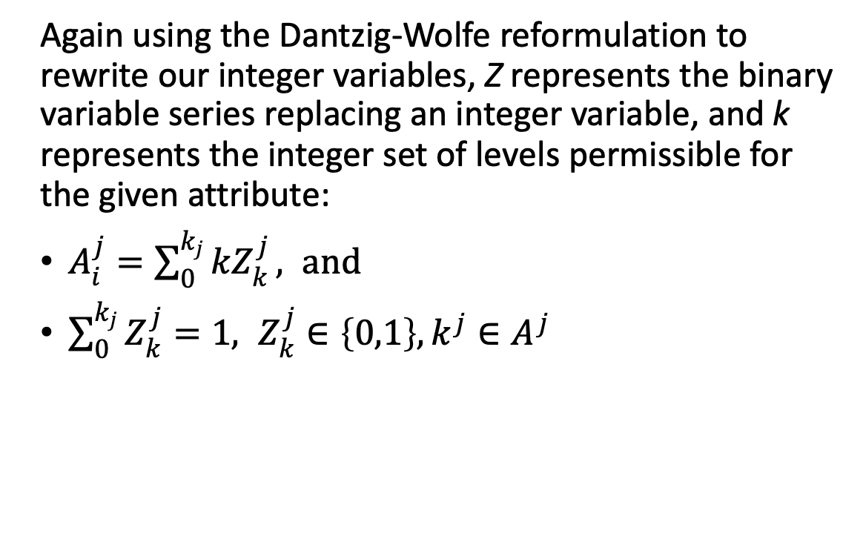
Reformulate the problem to define slacks more easily:
Again using the Dantzig-Wolfe reformulation to rewrite our integer variables, Z represents the binary variable series replacing an integer variable, and k represents the integer set of levels permissible for the given attribute:
$A_{i}^{j}=\sum_{0}^{k_{j}}{{kZ}_{k}^{j}}, and$
$\sum_{0}^{k_{j}}{Z_{k}^{j}}=1, Z_{k}^{j}∈\left\{0,1\right\}, k^{j}∈A^{j}$
Subject to:
Age group proportions:
$\frac{\sum{Z_{0}^{1}}}{N}=.25+δ_{d}^{A0}$
$\frac{\sum{Z_{1}^{1}}}{N}=.5+δ_{d}^{A1}$
$\frac{\sum{Z_{2}^{1}}}{N}=.25+δ_{d}^{A2}$
Interaction Constraints:
$Z_{0}^{5}+Z_{3}^{10}=1 +δ_{i}^{1}$
$Z_{1}^{5}+Z_{0}^{10}=1+δ_{i}^{2}$

Slide 11
Standard Solution Approach: Fedorov Algorithm
The standard method to identify an efficient design is to use one of any variant of the Fedorov Algorithm:
Given a starting design, recursively exchanges rows between the design matrix and the set of possible rows that reduce D-error until some convergence criteria is met.
This method is susceptible to local minima; it may be necessary to run multiple iterations of the Fedorov Algorithm with different random starting designs to find the most efficient design.

Slide 12
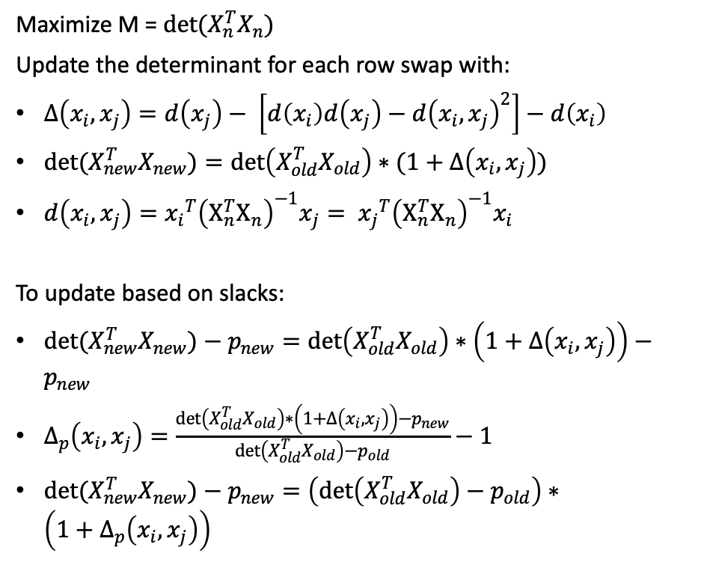
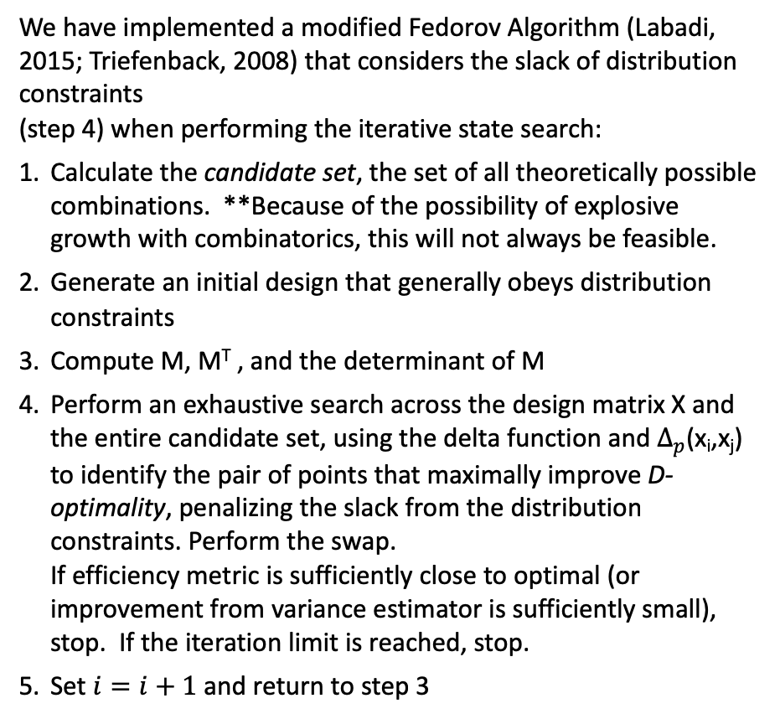
Modified Fedorov Algorithm: how do we penalize distribution and interaction slacks?
We have implemented a modified Fedorov Algorithm (Labadi, 2015; Triefenback, 2008) that considers the slack of distribution constraints (step 4) when performing the iterative state search:
Calculate the candidate set, the set of all theoretically possible combinations. **Because of the possibility of explosive growth with combinatorics, this will not always be feasible.
Generate an initial design that generally obeys distribution constraints
Compute M, M^{T} , and the determinant of M
Perform an exhaustive search across the design matrix X and the entire candidate set, using the delta function and $Δ_{p}$(x_{i},x_{j}) to identify the pair of points that maximally improve D-optimality, penalizing the slack from the distribution constraints. Perform the swap. If efficiency metric is sufficiently close to optimal (or improvement from variance estimator is sufficiently small), stop. If the iteration limit is reached, stop.
Set $i=i+1$ and return to step 3
Maximize M = $det⁡(X_{n}^{T}X_{n})$
Update the determinant for each row swap with:
$Δ\left(x_{i},x_{j}\right)=d\left(x_{j}\right)− \left[d\left(x_{i}\right)d\left(x_{j}\right)−{d\left(x_{i},x_{j}\right)}^{2}\right]−d\left(x_{i}\right)$
${det(X}_{new}^{T}X_{new})=\det\left(X_{old}^{T}X_{old}\right)∗(1+Δ\left(x_{i},x_{j}\right))$
$d\left(x_{i},x_{j}\right)={x_{i}}^{T}{\left(X_{n}^{T}X_{n}\right)}^{−1}x_{j}= {x_{j}}^{T}{\left(X_{n}^{T}X_{n}\right)}^{−1}x_{i}$
To update based on slacks:
${det(X}_{new}^{T}X_{new})−p_{new}=\det\left(X_{old}^{T}X_{old}\right)∗\left(1+Δ\left(x_{i},x_{j}\right)\right)−p_{new}$
$Δ_{p}\left(x_{i},x_{j}\right)=\frac{\det\left(X_{old}^{T}X_{old}\right)∗\left(1+Δ\left(x_{i},x_{j}\right)\right)−p_{new}}{\det\left(X_{old}^{T}X_{old}\right)−p_{old}}−1$
${det(X}_{new}^{T}X_{new})−p_{new}=\left(\det\left(X_{old}^{T}X_{old}\right)−p_{old}\right)∗\left({1+Δ}_{p}\left(x_{i},x_{j}\right)\right)$

Slide 13
Exhaustive iterative/recursive search is expensive (time, memory, energy)! How can we speed it up?
3
Genetic Algorithm:
Generate the initial herd of size population – a list of randomly generated designs
Calculate the d-optimality of each. Preserve some number of elites.
Breed random pairs of the non-elite stock (i.e., generate 2 new designs with random 50% from each parent).
Randomly mutate cells within the children.
Recombine the herd and assess the fitness (d-optimality) of each. Cull the poor performers, keeping only population.
Identify the most fit of the new generation; compare fitness to best from prior generation. If fitness increase is sufficiently large, increment the number of generations and go back to step 2. Otherwise stop. If the maximum number of generations is reached, stop.
1
2
4
5

Slide 14
Results
Toy Problem (3 attributes, 8 rows)
Full Problem
Algorithm | Lambda | Time (sec) | Iterations | D-optimality | Improvement
Random Draw |  |  |  | 53.1
Fedorov | 1 | 20.1 | 100 | 35.3 | -17.8
Genetic | 1 | 1.1 | 25 | 130.2 | 77.1
Parallel Genetic | 1 | 6.6 | 24 | 130.2 | 77.1
Fedorov | 0 | 2.0 | 10 | 131.0 | 76.3
Genetic | 0 | 1.3 | 25 | 131.0 | 76.3
Parallel Genetic | 0 | 7.3 | 28 | 131.0 | 76.3
Algorithm | Lambda | Time (sec) | Iterations | D-optimality | Improvement
Random Draw |  |  |  | 22.9
Genetic | 1 | 19.2 | 44 | 47.1 | 24.2
Parallel Genetic | 1 | 23.4 | 65 | 52.9 | 30.0
Genetic | 0 | 13.4 | 31 | 77.7 | 17.8
Parallel Genetic | 0 | 24.8 | 69 | 80.9 | 21.0

